Slide 1
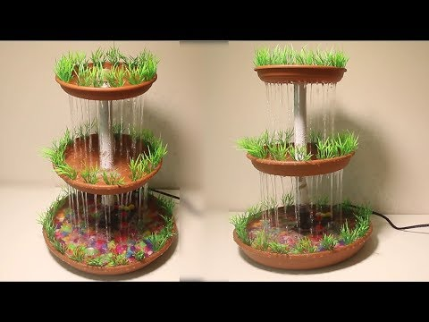
SMART WATER FOUNTAIN
BY….,
SABITHA .N

Slide 2
PROBLEM STATEMENT :
When the water flow does not have any restrict , there is lose of water in household as well as environment .
The lack of fountains in a community can have a number of negative consequences for people, the environment, and the local economy.

Slide 3
Project statement
HARDWARE
First we start by using the Wio Node and a relay ,also going to a screen for feedback and text.Using the relay we can control the power supply.
SOFTWARE
The hardware is all connected ,its time to setup the software . We will use the Wio app by seeed.

Slide 4
design
STEP 1: Install Android/iOS App
STEP 2: Create your Account
STEP 3: Connect Wio Node to Internet
STEP 4: Virtually interconnect modules with Wio Node and update firmware
Here is where we add the 2 components
Relay
OLED

Slide 5
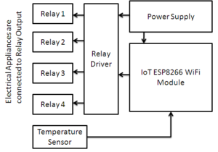
Block diagram

Slide 6
Explanation:
ESP8266 :
The ESP8266 WiFi Module is a self contained SOC with integrated TCP/IP protocol stack that can give any microcontroller access to your WiFi network.
RELAY :
A power relay module is an electrical switch that is operated by an electromagnet. The electromagnet is activated by a separate low-power signal from a micro controller.

Slide 7
RELAY DRIVER :
The Relay Driver™ is a logic module which provides high level system control functions such as high/low voltage alarms, load control and generator start.
TEMPERTURE SENSOR :
Temperature sensors work by providing readings via electrical signals. Sensors are composed of two metals that generate an electrical voltage or resistance when a temperature change occurs by measuring the voltage across the diode terminals.

Slide 8


